Slide 1

VISUALIZING COMPLEX BACTERIAL POPULATIONS
IN ANIMAL MODELS
Giovanni Widmer
Infectious Diseases & Global Health
Cummings School of Veterinary Medicine at Tufts University

Slide 2
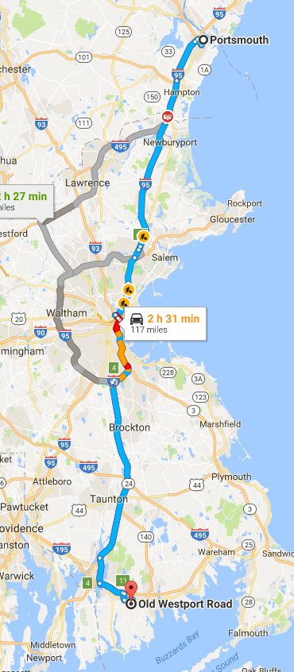
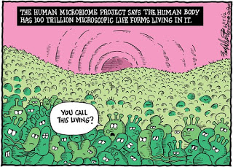
According to newer estimates, there are 0.9 x 10¹¹ bacteria in a gram of feces.

Slide 3
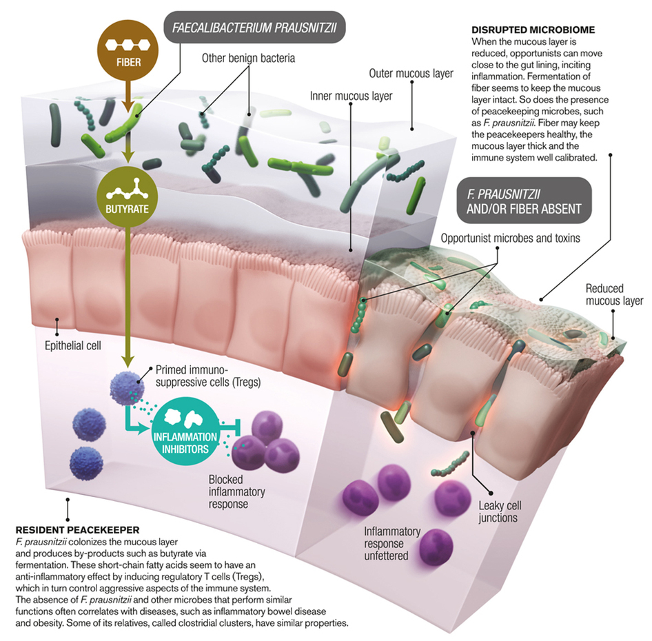
MICROBIOME PROTECTIVE
FUNCTION
Notes:
Science, Vol. 341; August 2, 2013

Slide 4
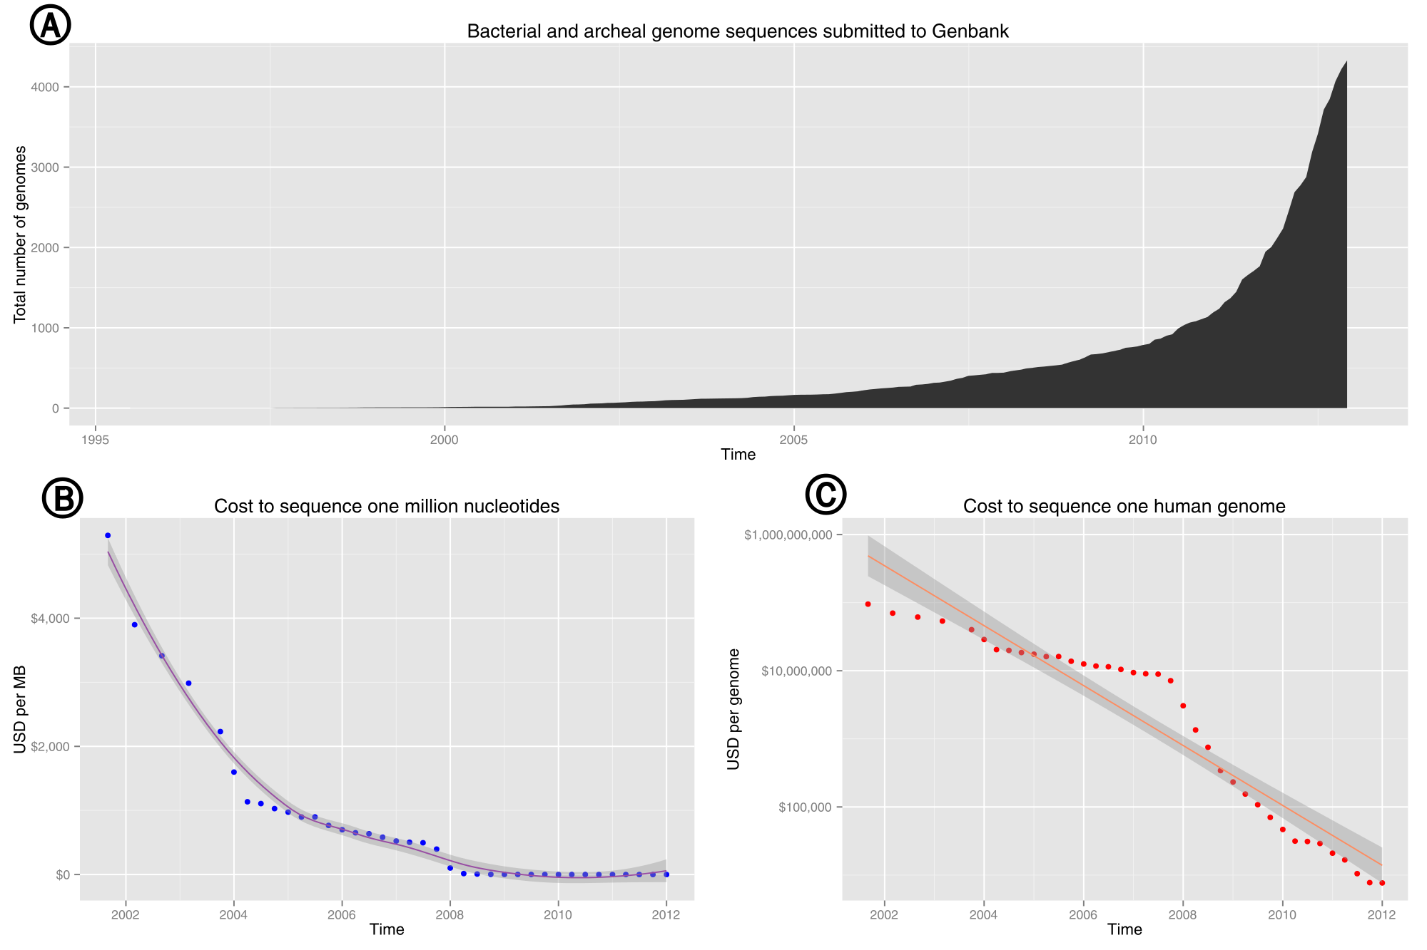
driving the science of omics: the rapidly falling cost of DNA sequencing
4000
0
$1,000,000,000
$4000
$10,000,000
$100,000
$0
Wikipedia

Slide 5

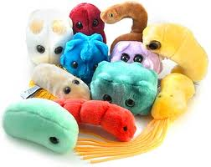
one technique - many applications
an individual
a bacterial microbiome
genome
re-sequencing
population DNA
RNA
16S amplicon
GWAS,
personalized
medicine,
conservation
transcriptome
(mRNA
cells, tissue, organism)
bacterial
population,
ecology
metagenome
(many genomes)
Notes:
main applications of high-throughput sequencing
GWAS: Genome Wise Association Study
Metagenome: the combined genomes of a population or sample (like a tumor or a tissue)
Transcriptome: all transcripts (mRNA, rRNA, tRNA, ncRNA...) from a sample.

Slide 6
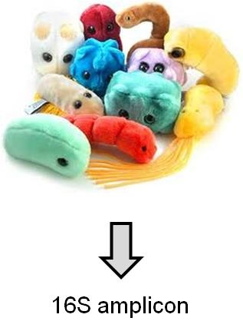
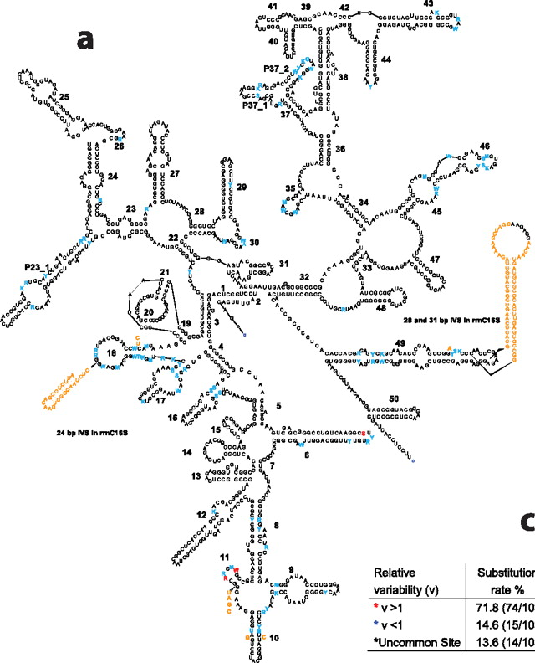
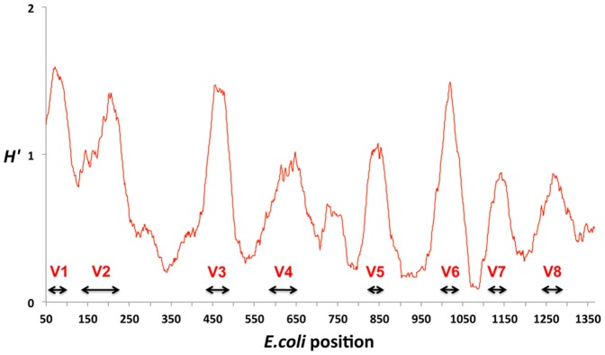
16S amplicon sequencing:
analysis of complex bacterial populations
16S rRNA gene
16S rRNA

Slide 7
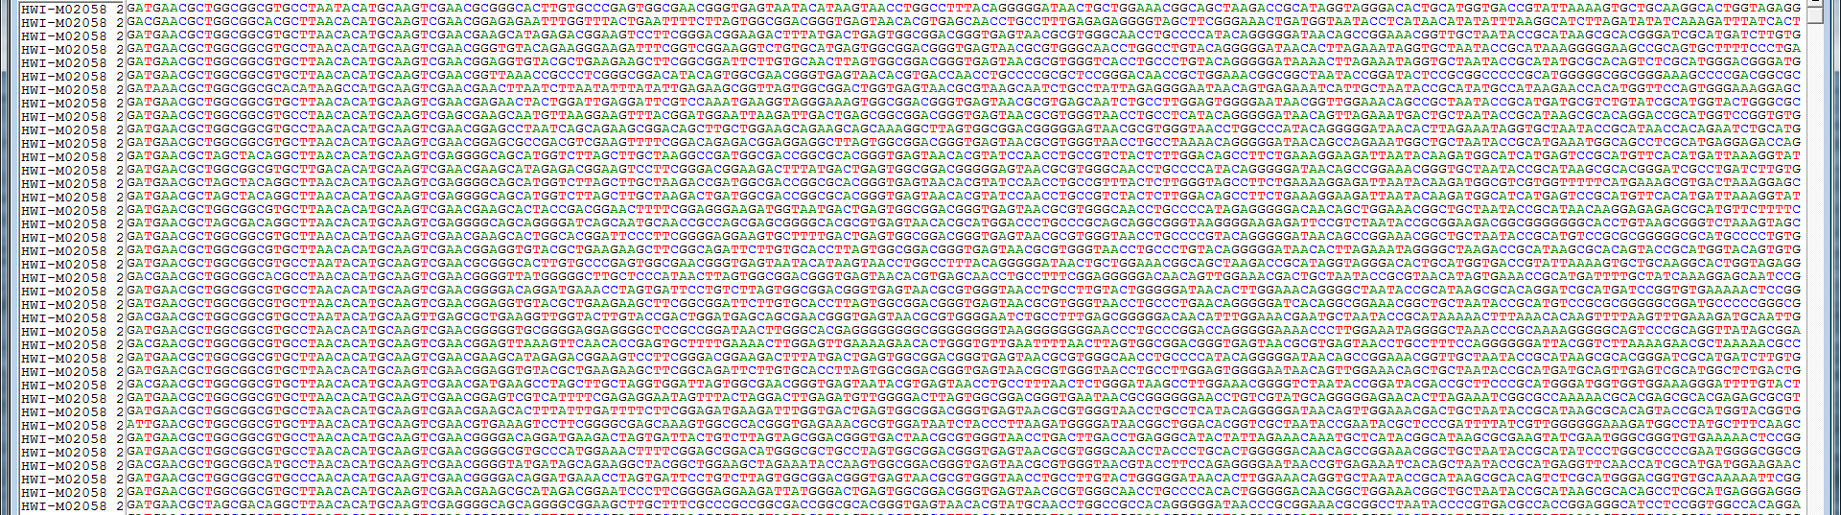
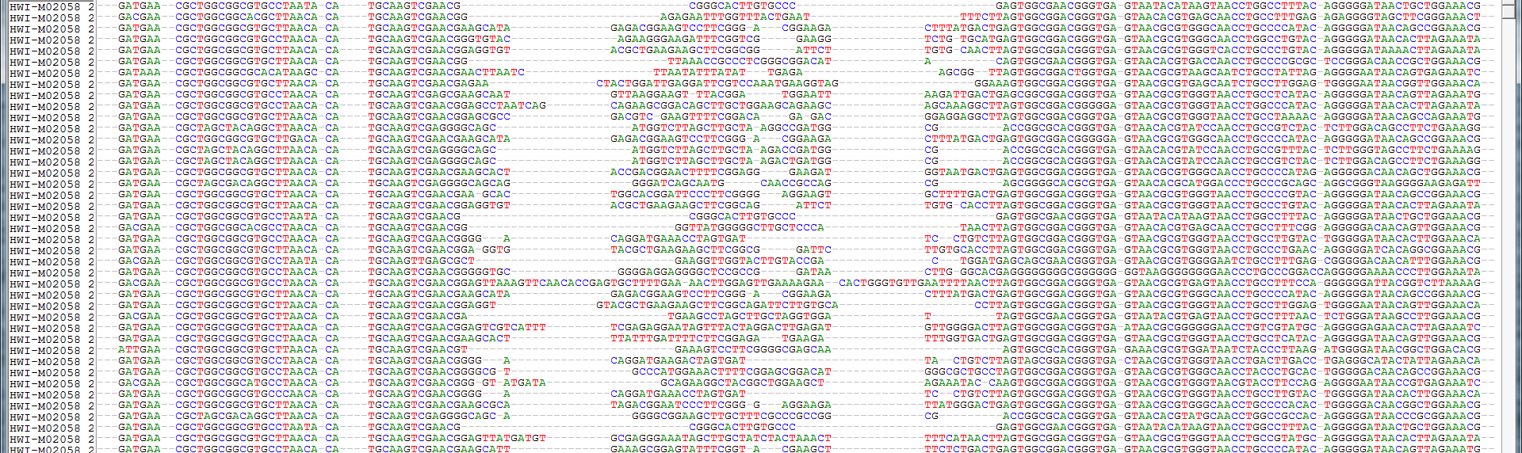
analysis pipeline
input
aligned
sequences
distance
matrix
clustering
visualization
hypothesis

Slide 8
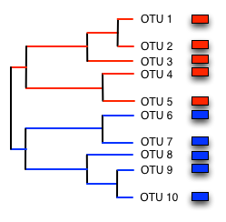
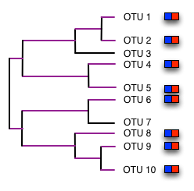
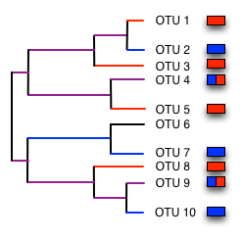
MEASURES OF DISTANCE
between sequences: D=k/N
between samples: UniFrac distance
sample 1
D = 1
sample 2
D = 0
sample 3
D = 0.5
species 1
species 2
Lozupone C, Knight R. UniFrac: a new phylogenetic method for comparing
microbial communities. Appl Environ Microbiol. 2005 Dec;71(12):8228-35.

Slide 9
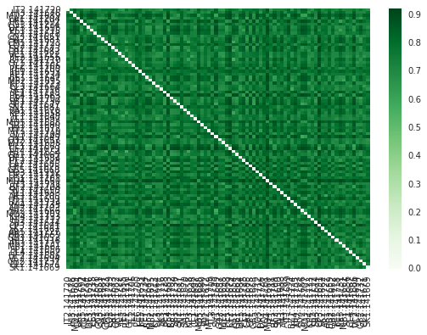
DISTANCE MATRIX

Slide 10
VISUALIZATION: UNCONSTRAINED VS CONSTRAINED ORDINATION

Slide 11
ORDINATION AND METADATA
constrained: Canonical Correspondence Analysis
unconstrained PCoA of fecal microbiome
Mann, Byrnes and Widmer, unpublished

Slide 12
rat fecal microbiome
taxonomy
(by family)
(Order Bacteriodales)
(Phylum Bacteriodetes)
days on diet
pre
3
10-12
30
function
(infered from 16S sequences)
pre
30
Mann and Widmer, unpublished

